Slide 1
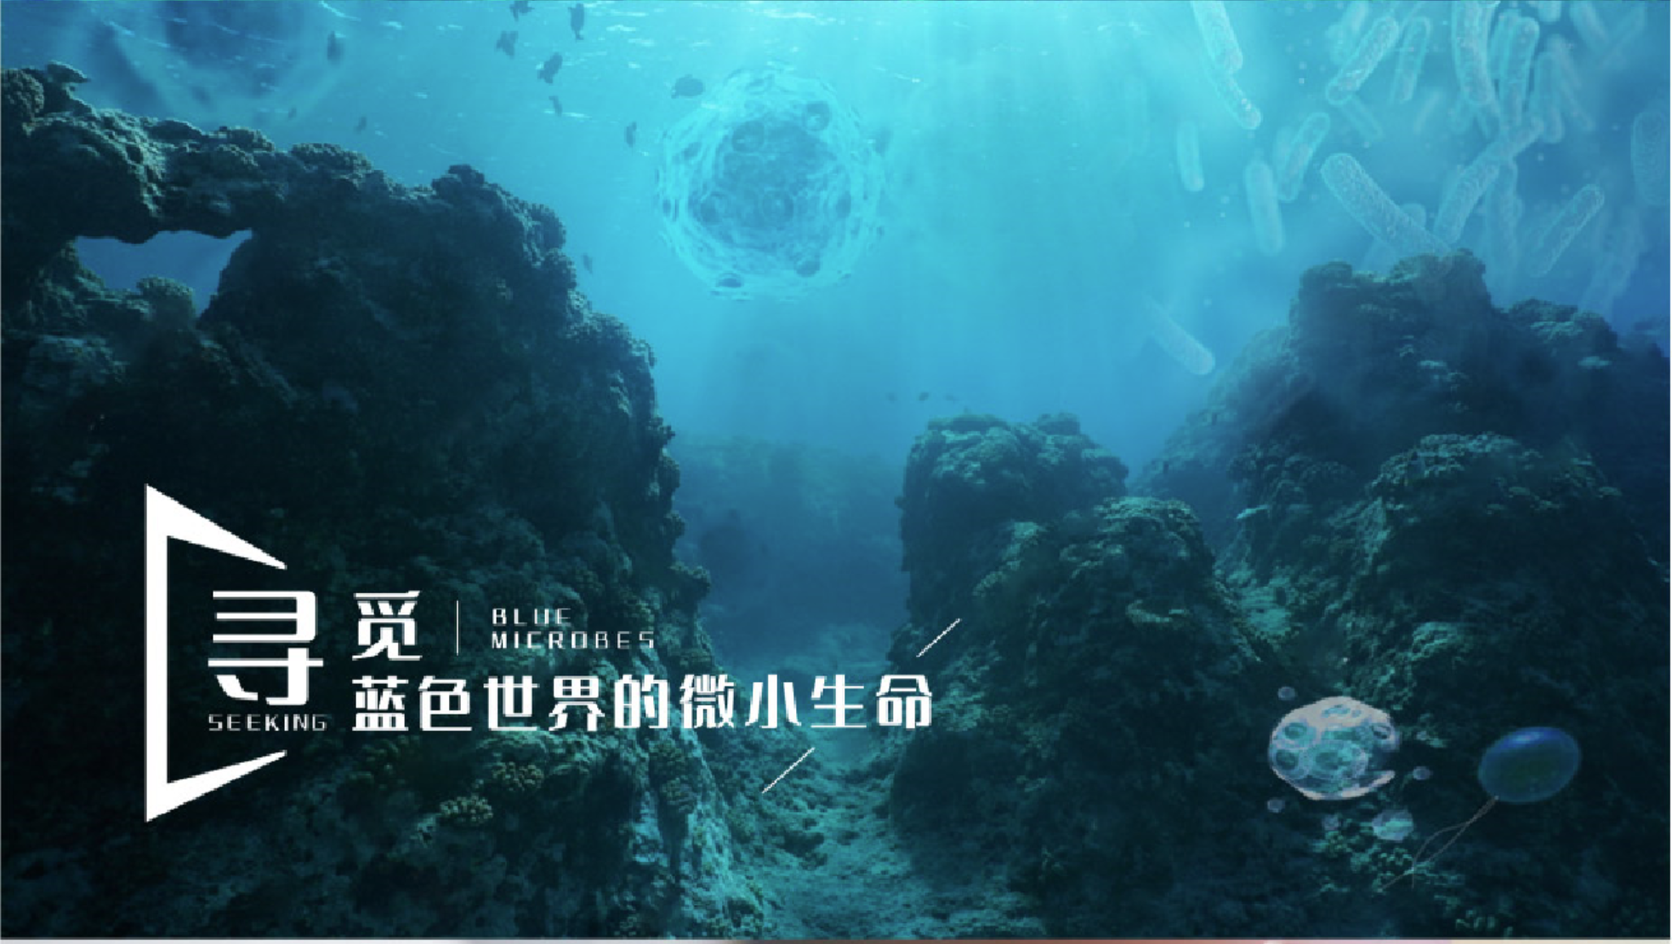
海洋微生物学及实验
2024-2025学年 冬第三周

Slide 2
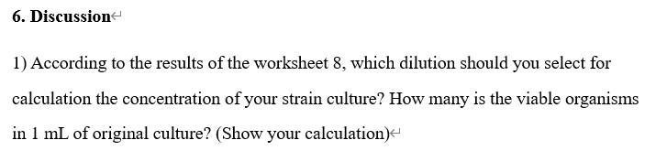
EXPERIMENT 8: Detection of colony-forming unit (CFU) 菌落形成单位
Exp.8, 9, 11实验报告反馈
Colonies/Volume × Dilution factor = viable cells/mL
If you chose 10⁻⁴ dilution, 300 colonies in 0.1 mL.
300/0.1×10⁴=3.0×10⁷ cells/mL
***出错的地方：
涂布的体积是0.1 mL （100 μL）
科学计数法
单位 （cells/mL）

Slide 3
EXPERIMENT 9: Methods of counting microbes-total cell counts
1) Did you count in the 4 × 4 large squares, or in the 5 × 5 small central squares? And in the squares you choose, how many cells you count in total?
4 × 4 large squares
120 (4 large squares)
OR
5 × 5 small central squares
120 (just 5 small squares)
B

Slide 4
EXPERIMENT 9: Methods of counting microbes-total cell counts
B
Page 66
When counting a high density cell population ( >10 in red square shown in Fig 9.1B), use the central (5 × 5) area, and count the 5 grey color small central squares (1/25 mm²);
at lower cell concentrations (≤10 in red square shown in Fig 9.1B), use the four (4 × 4) large corner squares (labeled “1”-“4”) as shown in Fig 9.1B, and record the number of small squares counted.

Slide 5
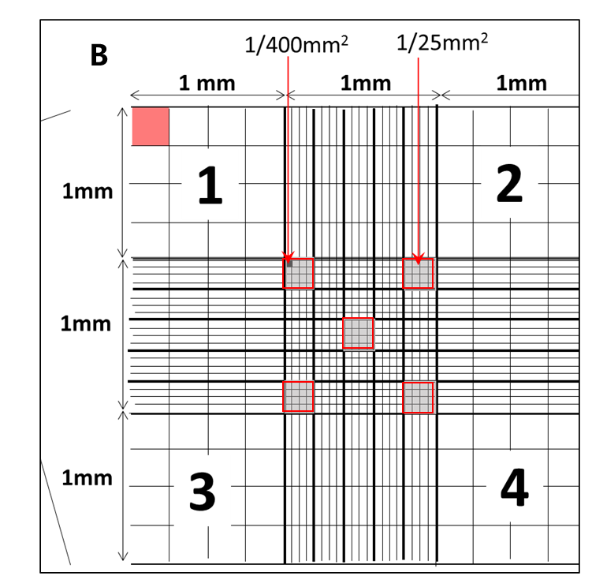
2) What is the volume of 4 large squares in total (“1”-“4” as shown in Fig 9.1B) in mL? What is the volume of the central square (5 × 5) in mL?
① 1 mm×1 mm×0.1 mm×4 = 0.4 mm³ = 4×10⁻⁴ mL
1 mm³ = 10⁻³ mL (cm³)
OR
0.1 cm×0.1 cm×0.01 cm×4 = 0.0004 mL=4×10⁻⁴ mL
② 1 mm×1 mm×0.1 mm×1 = 0.1 mm³ = 1×10⁻⁴ mL
OR
0.1 cm×0.1 cm×0.01 cm×1 = 0.0001 mL=1×10⁻⁴ mL

Slide 6
3) According to the number of the cells you count and the volume of the squares you choose, show your calculations to determine the number of cells per ml in the suspension.
If you count cells in 4 × 4 large squares,
120/the volume of the 4 × 4 large squares ×dilution factor (if dilute, 本实验稀释了10倍)
120 / (4×10⁻⁴) ×10 = 3.0×10⁶ cells/mL
If you count cells in in the 5 × 5 small central squares,
120×5/the volume of the central squares×dilution factor (if dilute, 本实验稀释了10倍)
120×5 / (1×10⁻⁴) ×10 = 6.0×10⁷ cells/mL

Slide 7
Spectrophotometer
4) What is the number of cells/mL as estimated using the spectrophotometer?
Y (cells/mL) =Dilute times × (10⁷ × OD₆₀₀-907614)
Not dilute, OD₆₀₀ was 0.801
1 × (10⁷ × 0.801 - 907614) = 7.1×10⁶ cells/mL
Exp.9 血球计数板 和 分光光度计 检测菌液来源于同一管菌，
血球计数板检测时稀释了10倍，分光光度计检测时未稀释
两个数值的数量级一致即可，都是10⁶或10⁷

Slide 8
1) Which is the direct method for determining cell numbers?
Using Neubauer Haemocytometer.
2) What is the basic difference between the cell counts obtained from the viable count method and the total count methods?
The viable count method——EXPERIMENT 8: Detection of colony-forming unit (CFU)
The total count methods ——EXPERIMENT 9: Methods of counting microbes-total cell counts

Slide 9
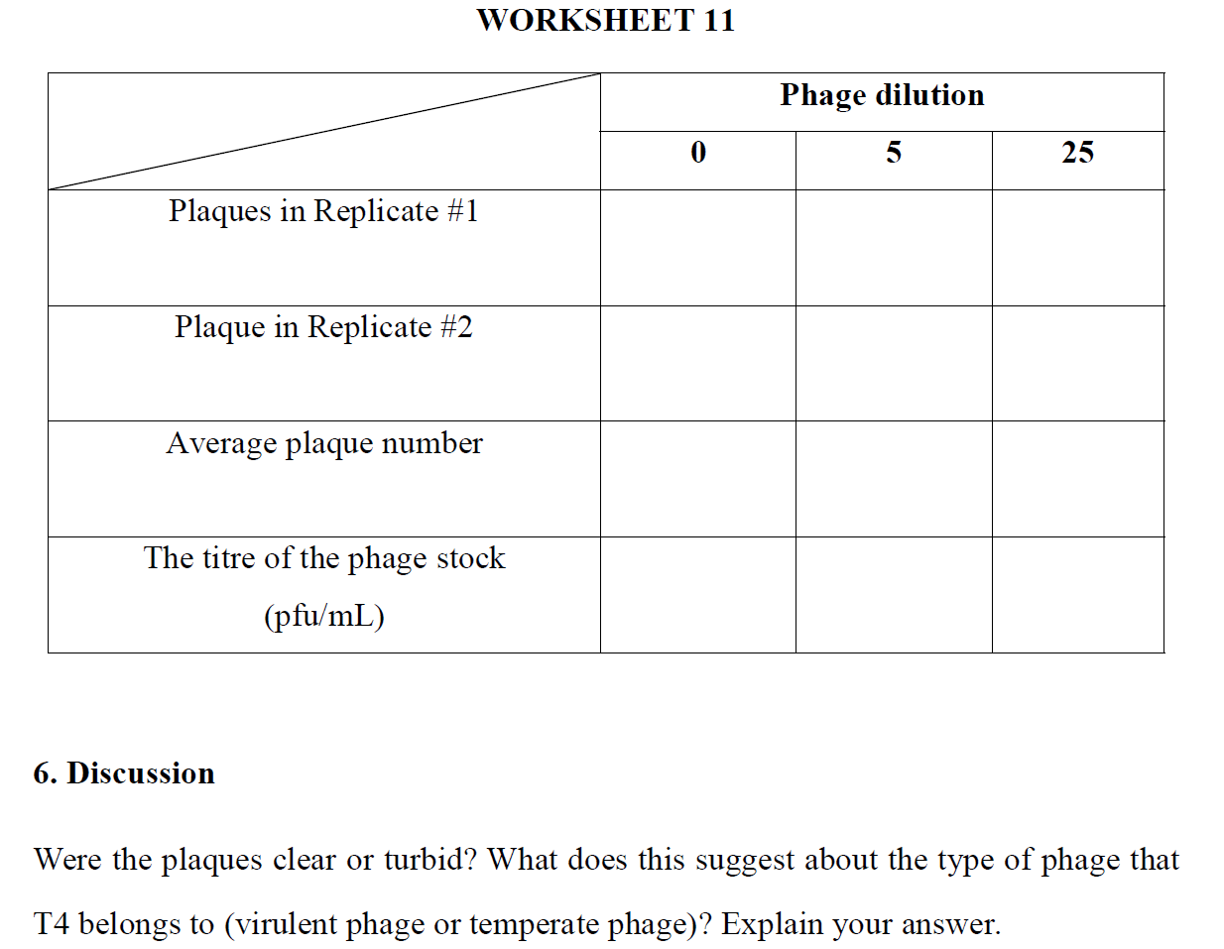
EXPERIMENT 11: Plaque assay of bacteriophages
/* / 26
/ / 35
- - 31
计算过程：
Plaque number ×dilution factor/volume
=31 ×25/0.01 mL
一定用科学计数法表示
- - 7.75×10⁴
* / means too many to count.

Slide 10
EXPERIMENT 11: Plaque assay of bacteriophages
/* / 26
/ / 35
- - 31
计算过程：
Plaque number ×dilution factor/volume
=31 ×25/0.01 mL
一定用科学计数法表示
- - 7.75×10⁴
* / means too many to count.

Slide 11
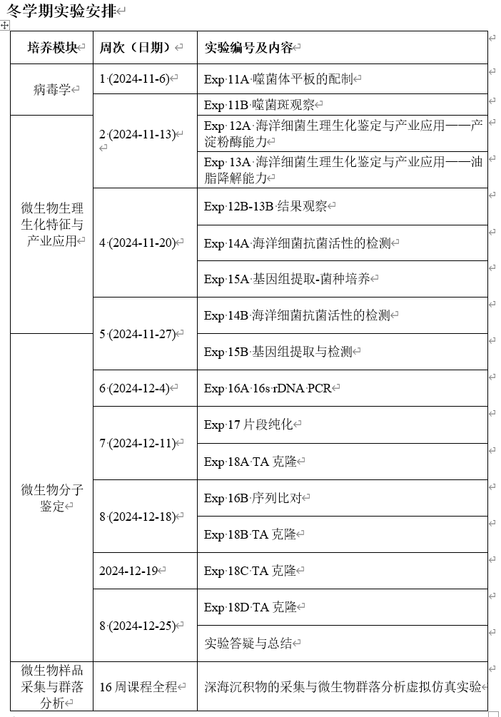

Slide 12
上周实验内容：
EXPERIMENT 12: Alpha-amylase, an industrial enzyme produced by marine bacteria
Expt. 12A
1 × TSA (labeled “TSA”)
1 × TSA plus 0.2% starch plate (labeled “TSA/0.2%S”)
Three overnight (O/N) strains cultures in 1.5 mL tubes:
Escherichia coli, labeled “Ec”
Bacillus subtilis, labeled “Bs”
Bacillus amyloliquefaciens (isolated from seawater), labeled “Ba”
Your culture of isolated strain, labeled “Y”.
10 μL pipette and tips

Slide 13
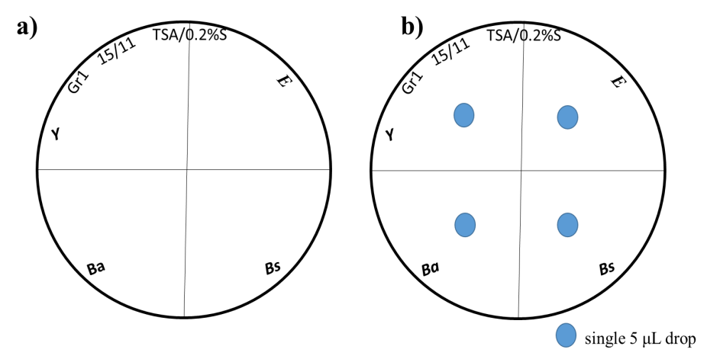
今天实验内容：
EXPERIMENT 12: α-amylase, an industrial enzyme produced by marine bacteria
EXP. 12B
Materials
2 × Iodine reagent in a 5 mL tube
Inoculated starch plates from Exp 12A
Piece of white paper

Slide 14
EXPERIMENT 13: Marine microbes in pollution control
上周实验内容： Expt. 13A
Materials
1 × LB agar plate (labeled “LB”)
1 × LB plus Oil plate (labeled “OIL”)
1 × LB plus Neutral Red plate (labeled “NB”)
1 × LB plus Oil and Neutral Red plate (labeled “OIL/NB”)
Fresh liquid culture of Pseudomonas aeruginosa in 1.5 mL tube
(labeled “Pa ”)
Fresh liquid culture of Staphylococcus epidermidis in 1.5 mL tube
(labeled “Se”)
Fresh liquid culture of E. coli in 1.5 mL tube (labeled “Ec”)
Fresh liquid culture of your strain in liquid culture (labeled “Y ”)

Slide 15
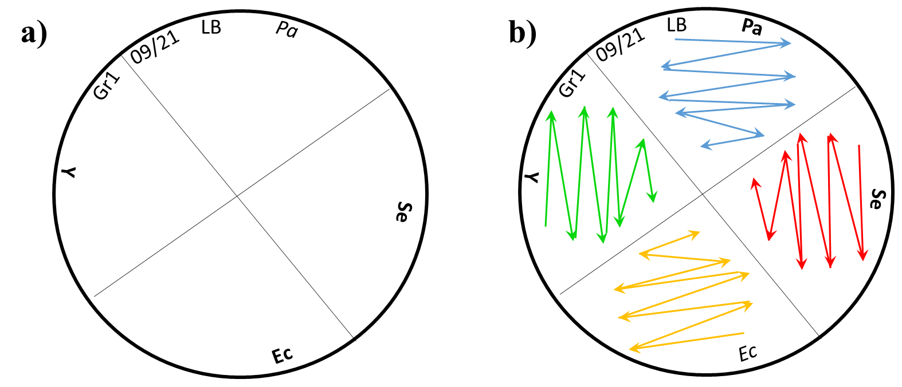
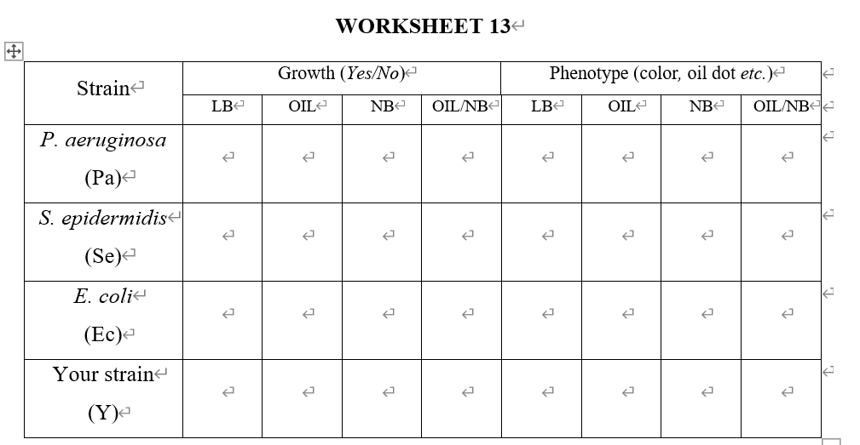
今天实验内容：
EXPERIMENT 13: Marine microbes in pollution control
Expt. 13B
Observe and record the change of the color around/on the strains.
Record results in worksheet 13.
表型
包括菌的颜色，菌落上是否有油点，油点的颜色等

Slide 16
***下周二前 (11月26日18 点前) 提交EXP 12、13 的实验报告，文件名按模板建议“姓名-学号-实验报告12”钉钉提交，收到后均会回复！

Slide 17
EXPERIMENT 14: Antibiotic sensitivity testing:
disc diffusion method
OBJECTIVES
At the end of this experiment you should:
Know how to determine the antibiotic sensitivities of different bacteria using disc diffusion
Understand some general properties of antibiotics including spectrum of action
Tell whether your isolated strain could produce antibiotics

Slide 18
EXPERIMENT 14: Antibiotic sensitivity testing:
disc diffusion method
MATERIALS
Sterile swabs 无菌棉签
Sterile tweezers 无菌镊子
Sterile filter paper discs in the plate 无菌纸片
3 × LB (Luria-Bertani) agar plates
Antibiotic solutions in 1.5 mL tubes containing:
Penicillin (P) Gentamicin (Ge)
Ampicillin (Ap) Tetracycline (Te)
Control: ddH₂O in 1.5 mL tube (ddH₂O)
Liquid Culture of your strain (Y).
Overnight LB cultures in 1.5 mL tubes:
Ec - Escherichia coli (ATCC35218)
Se - Staphylococcus epidermidis (ATCC12228)
Pa - Pseudomonas aeruginosa (ATCC27853)
铝箔纸包裹灭菌，
烘干

Slide 19
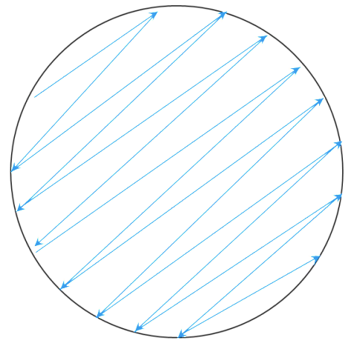
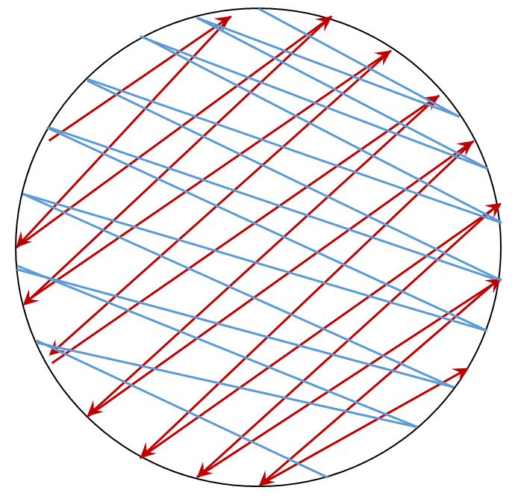
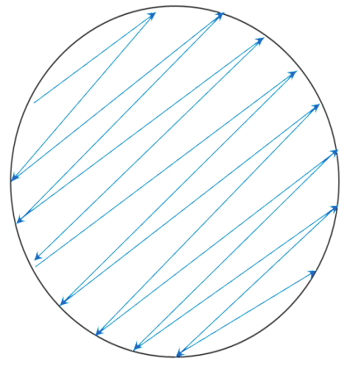
EXPERIMENT 14: Antibiotic sensitivity testing: disc diffusion method
METHODS
In sterile hood, label 3 LB plates Ec, Se, Pa as described in lab manual.
Dip the a sterile swab into the E. coli and rub it lightly over the entire surface of the Ec plate. The surface should be swabbed three times at different angles so that the agar surface is completely covered.
Repeat for S. epidermidis and Ps. aeruginosa, using fresh swabs for each plate. Each student should swab at least one plate.
Leave the plates at least 15 min to allow the liquid culture to soak into the agar.
Swab at different angle
Swab at different angle

Slide 20
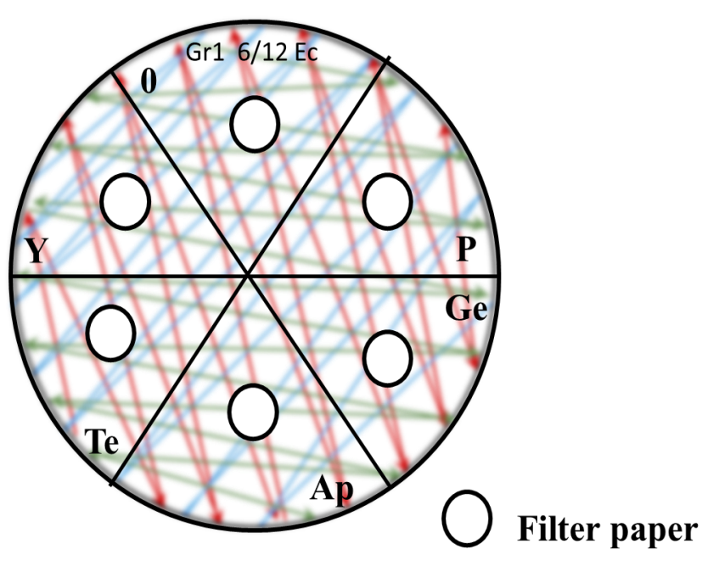
Divide the base of each plate into 6 sections and label the sections 0, P, Ge, Ap, Te, and Y as in Fig14.2.
Place 6 filter paper discs on the agar surface of each plate using sterile tweezers as in Fig14.2.
NOTE: When placing discs on agar plates swabbed with different strains, flame your tweezers before placing.
Add 3 μL penicillin onto the sterile filter disc in plate section “P” by the pipette. Use a single tip for all three LB plates (Ec, Se and Pa), but be careful not to contaminate the tip by touching the agar surface.
Add the other antibiotics as in step 7. For section “0” add 3 μL ddH₂O as a control.
Parafilm and incubate for > 18 h at 37 ℃.
For Exp 15 基因组提取 next week (Exp15A)
Culture your strain in fresh LB medium.
1 -5% (v/v) fresh medium (20 mL) inoculate your strain
“0” means ddH₂O

